Slide 1
Screening Patients for Substance Use in Your Practice Setting

Slide 2
Learning Objectives
By the end of this session, participants will—
Understand the rationale for universal screening.
Identify potential health impact of substance misuse and abuse.
Identify substance use risk limits.
Identify how screening is conducted in a practice setting, including prescreening and screening.
Practice how to use two screening tools.
Understand how screening is used in brief intervention.

Slide 3
Rationale for Universal Screening
Drinking and drug use are common.
Drinking and drug use can increase the risk for health problems, safety risks, and a host of other issues.
Drinking and drug use often go undetected.
People are more open to change than you might expect.

Slide 4
Why Screen Universally?
Detect current health problems related to at-risk alcohol and substance use at an early stage—before they result in more serious disease or other health problems.
Detect alcohol and substance use patterns that can increase future injury or illness risks.
Intervene and educate about at-risk alcohol and other substance use.
Research has shown that approximately 90 percent of substance use disorders go untreated. (NSDUH, 2007).
Notes:
4

Slide 5
Detecting Risk Factors Early
Screening can be a significant step toward effective intervention:
The clinician is often the first point of contact.
Early identification and intervention lead to better outcomes.
Patients are often seen by a clinician because of a related physical problem.
Source: Treatnet. (2008). Screening, assessment and treatment planning. Retrieved from http://www.unodc.org/ddt-training/treatment/a.html

Slide 6
Prevalence of Substance Use
Substance | Female | Male
Tobacco | 22.5% | 32.5%
Alcohol (current drinkers) | 45.9% | 57.7%
Illicit Drugs | 6.3% | 9.9%
Misuse of Prescription Drugs | 2.4% | 2.6%

Slide 7
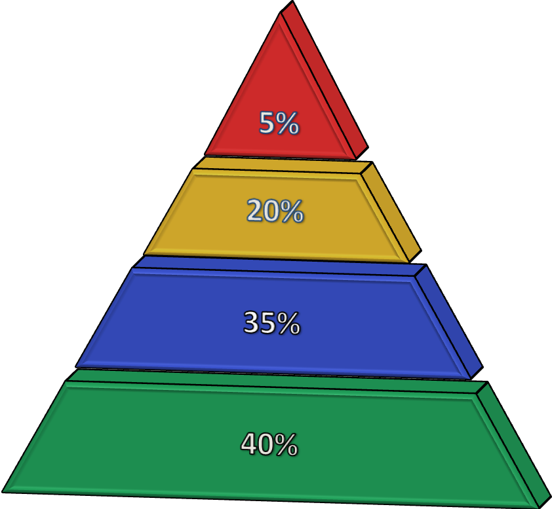
Based on Findings of Screening
Dependent Use
Harmful Use
At-Risk Use
Low Risk

Slide 8
Health Impacts: Alcohol/Drugs
Hypertension, dyslipidemia, heart disease
Liver disease, gastritis, pancreatitis
Depression, sleep dysfunction
Risk for breast, colon, esophageal, head, and neck cancers
HIV/AIDS, other STIs, and other infectious diseases
Trauma, disability

Slide 9
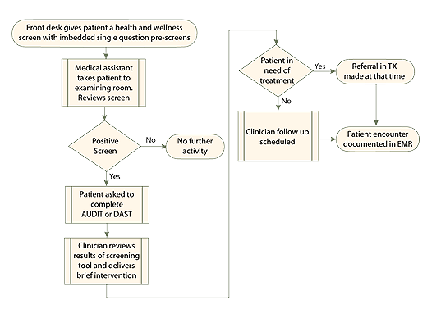
Screening in a Practice Setting
Most practices use a teaming approach

Slide 10
Prescreening Strategy
Negative
Based on previous experiences with SBIRT, screening will yield 75% negative responses.
Positive
If you get a positive screen, you should ask further assessment questions.
Use brief yet valid prescreening questions:
The NIAAA Single-Question Screen or the AUDIT C
The NIDA Single-Question Drug Screen

Slide 11
Alcohol Prescreening
Prescreen: Do you sometimes drink beer, wine, or other alcoholic beverages?
NO
YES
AUDIT C: How often do you have a drink containing alcohol? How many standard drinks containing alcohol do you have on a typical day? 3. How often do you have six or more drinks on one occasion?
Sensitivity/Specificity:
Male: 86%/89%
Female: 73%/91%
Male score of 4 or more, Female score 2 or more, complete full screen.
Source: www.integration.samhsa.gov/images/res/tool_auditc.pdf‎

Slide 12
Prescreening Drinking Limits
Determine the average drinks per day and average drinks per week—ask:
Recommended Limits
Men = 2 per day/14 per week
Women/anyone 65+ = 1 per day or 7 drinks per week
> Regular limits = at-risk drinker
On average, how many days a week do you have an alcoholic drink?
On a typical drinking day, how many drinks do you have? (Daily average)
Weekly average = days X drinks

Slide 13
A Positive Alcohol Screen = At-Risk Drinker
Binge drink
(≥5 for men or ≥4 for women/anyone 65+)
Or patient exceeds regular limits?
(Men: 2/day or 14/week
Women/anyone 65+: 1/day or 7/week)
NO
Patient is at low risk.
YES
Patient is at risk. Screen for maladaptive pattern of use and clinically significant alcohol impairment using AUDIT.
Notes:
13

Slide 14
Evidence Behind the Numbers
Studies demonstrate that the 5+/4+ limits accurately reflect the amount of alcohol consumed at which psychomotor and cognitive impairment is notably increased in both men and women.
Epidemiologic risk curve analyses reveal significant and rapid increases in the risks of—
Unintentional injuries
Deaths resulting from external causes
Being a target of aggression or taking part in an aggression-related event
Alcohol use disorders
Unfavorable medical, work-related, legal, and social consequences related to drinking
As the frequency of exceeding NIAAA’S guidelines increases, the likelihood of developing these problems increases.

Slide 15
NIAAA Epidemiologic Studies
NIAAA conducted extensive, nationally representative, epidemiologic surveys including—
National Longitudinal Alcohol Epidemiologic Survey—NLAES (1992)
National Epidemiologic Survey on Alcohol and Related Conditions—NESARC (2001–2002)
NESARC 3-year followup (2004–2005)
The surveys included questions regarding the frequency with which people drank more than five drinks in a given day.
Findings indicated that exceeding these drinking limits can significantly increase alcohol-related health problems.

Slide 16
When Screening, It’s Useful To Clarify What One Drink Is!

Slide 17
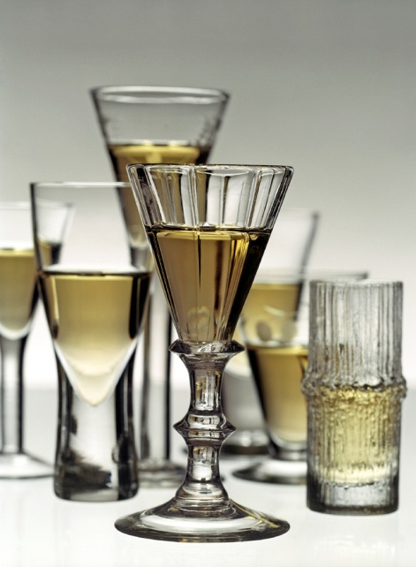
How Much Is “One Drink”?
5-oz glass of wine
(5 glasses in one bottle)
12-oz glass of beer (one can)
1.5-oz spirits
80-proof
1 jigger
Equivalent to 14 grams pure alcohol

Slide 18
AUDIT Alcohol Use Disorders Identification Test
What is it?
Ten questions, self-administered or through an interview; addresses recent alcohol use, alcohol dependence symptoms, and alcohol-related problems
Developed by World Health Organization (WHO)

Slide 19
AUDIT Alcohol Use Disorders Identification Test
What are the strengths?
Public domain—test and manual are free
Validated in multiple settings, including primary care
Brief, flexible
Focuses on recent alcohol use
Consistent with ICD-10 and DSM IV definitions of alcohol dependence, abuse, and harmful alcohol use
Limitations?
Does not screen for drug use or abuse, only alcohol

Slide 20
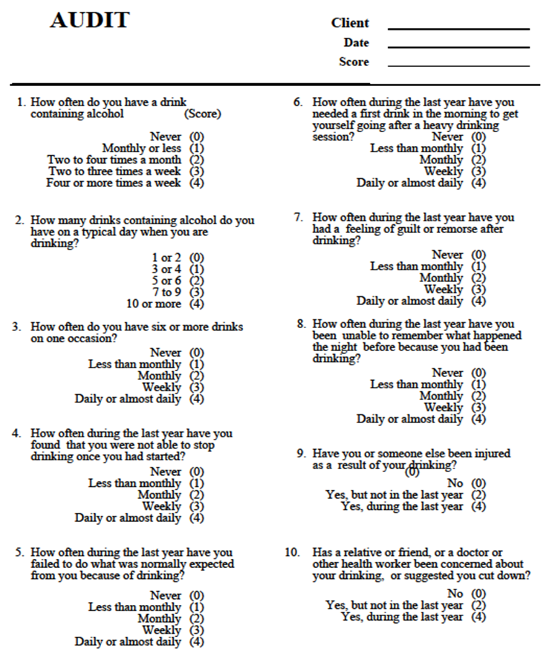
AUDIT Questionnaire
WHO, 1992

Slide 21
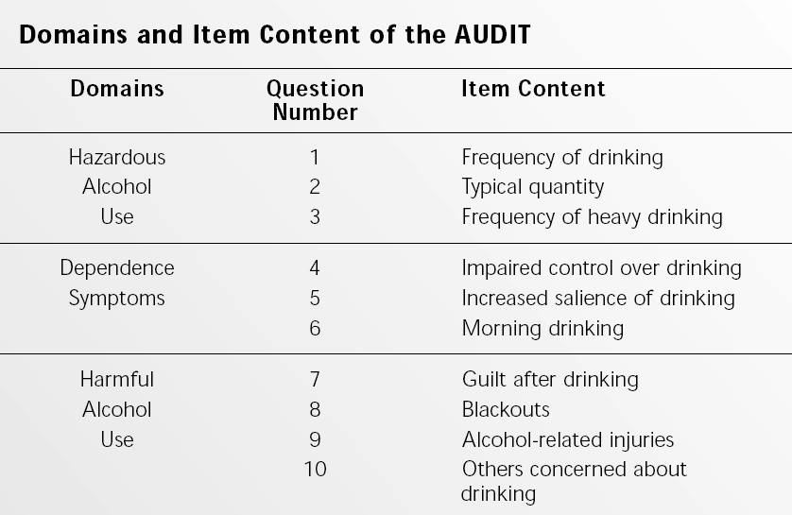
AUDIT Domain
WHO, 1992

Slide 22
Scoring the AUDIT
Dependent Use (20+)
Harmful Use (16‒19)
At-Risk Use (8‒15)
Low Risk (0‒7)

Slide 23
Practice Session
Screening Using the AUDIT

Slide 24
Prescreening for Drugs
“How many times in the past year have you used an illegal drug or used a prescription medication for nonmedical reasons?”
(…for instance because of the feeling it caused or experiences you have…)
If response is, “None,” screening is complete.
If response contains suspicious clues, inquire further.
Sensitivity/Specificity: 100%/74%
Source: Smith, P. C., Schmidt, S. M., Allensworth-Davies, D., & Saitz, R. (2010). A single-question screening test for drug use in primary care. Arch Intern Med ,170(13), 1155−1160.

Slide 25
A Positive Drug Screen
ANY positive on the drug prescreen question puts the patient in an “at-risk” category. The followup questions are to assess impact and whether substance use is serious enough to warrant a substance use disorder diagnosis.
Ask which drugs the patient has been using, such as
cocaine, meth, heroin, ecstasy, marijuana, opioids, etc.
Determine frequency and quantity.
Ask about negative impacts.

Slide 26
Prescription Drug Misuse
Although many people take medications that are not prescribed to them, we are primarily concerned with—
Opioids (oxycodone, hydrocodone, fentanyl, methadone)
Benzodiazepines (clonazepam, alprazolam, diazepam)
Stimulants (amphetamine, dextroamphetamine, methylphenidate
Sleep aids (zolpidem, zaleplon, eszopicione)
Other assorted (clonidine, carisoprodol)

Slide 27
DAST (10)
What is it?
Shortened version of DAST 28, containing 10 items, completed as self-report or via interview. DAST(10) consists of screening questions for at-risk drug use that parallel the MAST (an alcohol screening instrument)
Developed by Addiction Research Foundation, now the Center for Addiction and Mental Health
Yields a quantitative index of problems related to drug misuse
What are the strengths?
Sensitive screening tool for at-risk drug use
What are the weaknesses?
Does not include alcohol use

Slide 28
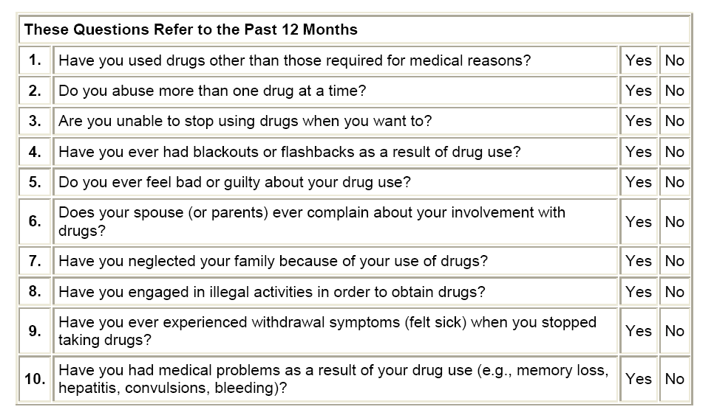
DAST(10) Questionnaire
Source: Yudko et al., 2007

Slide 29
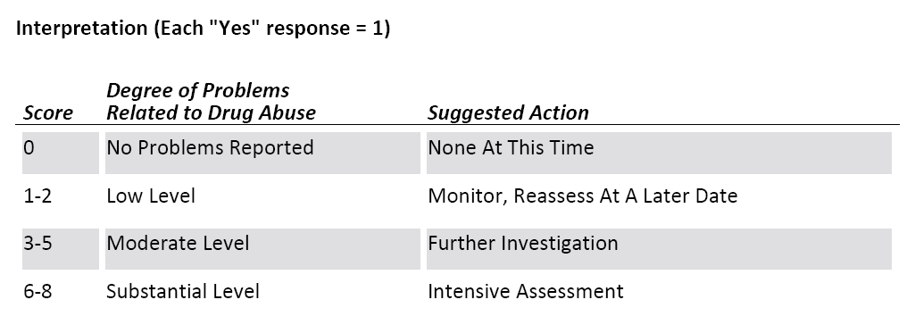
DAST(10) Interpretation
Yudko et al., 2007

Slide 30
Scoring the DAST(10)
High Risk (6+)
Harmful Use (3‒5)
Hazardous Use (1‒2)
Abstainers (0)

Slide 31
Key Points for Screening
Screen everyone.
Screen both alcohol and drug use including prescription drug abuse and tobacco.
Use a validated tool.
Prescreening is usually part of another health and wellness survey.
Explore each substance; many patients use more than one.
Follow up positives or "red flags" by assessing details and consequences of use.
Use your MI skills and show nonjudgmental, empathic verbal and nonverbal behaviors during screening.
Notes:
31

Slide 32
Screening: Summary
Screening is the first step of the SBIRT process and determines the severity and risk level of the patient’s substance use.
The result of a screen allows the provider to determine if a brief intervention or referral to treatment is a necessary next step for the patient.
Notes:
32

Slide 33
Based on Findings of Screening
The clinician has valid, patient self-reported information that is used in brief intervention.
Often the process of screening sets in motion patient reflection on their substance use behavior.

Slide 34
Question?

