Slide 1
Motivational Interviewing:
Enhancing Motivation To Change Strategies

Slide 2
Learning Objectives
At the end of this session, you will be able to—
Describe the stages of change.
Demonstrate at least two methods to elicit change talk.
Use a decisional balance and readiness ruler.
Describe an overarching motivational interviewing (MI) strategy effective in brief intervention.

Slide 3
Stages of Change

Slide 4
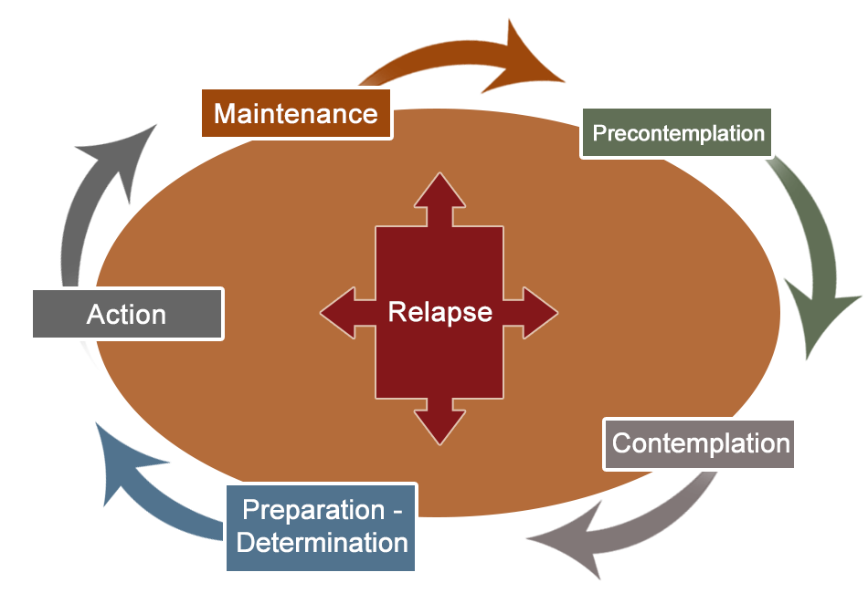
Theoretical Framework
Informing MI
Prochaska and DiClemente identified five stages of change your patient can experience:
Precontemplation
Contemplation
Preparation
Action
Maintenance
Prochaska & DiClemente (1984)

Slide 5

MI Informed by Stages of Change
(continued)
Precontemplation
The patient is not yet recognizing problem or considering change.
Clinician’s goal is to build rapport and raise awareness.
Clinician’s task is to inform and encourage.

Slide 6

MI Informed by Stages of Change
(continued)
Contemplation
The patient is evaluating reasons for and against change.
Clinician’s goal is to build motivation.
Clinician’s task is to explore and resolve ambivalence.

Slide 7
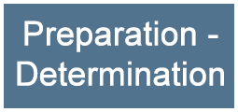
MI Informed by Stages of Change
(continued)
Preparation
The patient is planning for change.
Clinician’s goal is to negotiate a plan.
Clinician’s task is to facilitate decisionmaking.

Slide 8

MI Informed by Stages of Change
(continued)
Action
The patient is making the identified change(s).
Clinician’s goal is to support implementation of the plan.
Clinician’s task is to support self-efficacy.

Slide 9

MI Informed by Stages of Change
(continued)
Maintenance
The patient is working to sustain change(s).
Clinician’s goal is to help maintain change.
Clinician’s task is to prevent relapse.

Slide 10
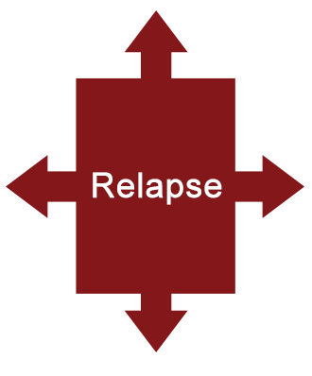
MI Informed by Stages of Change
(continued)
Relapse
  Event(s) trigger the individual to return to previous behaviors.
  Reengage.
  Review goals and strategies.
  Recurrence does not equal failure.

Slide 11
Learning Exercise
At what stage does a patient consider the possibility of change?
Precontemplation
Contemplation
Preparation
Action

Slide 12

Remember
“Readiness to change”
State
Trait

Slide 13
Change Talk

Slide 14
Increasing Change Talk
Change talk is at the heart of MI. Through our conversations, we elicit—
Desire – I wish/want to…
Ability – I can/could…
Reasons – It’s important because…
Need – I have to…

Slide 15


What Is Change Talk?
Change talk
Patient expresses motivation to change.
Example
“I wish I could stop drinking so much because I don’t want that to be an example for my children.”

Slide 16
Learning Exercise
Identify the change talk statements:
I have to cut down on my drinking so I can make it to work on time.
My spouse wants me to give up cigarettes.
The doctor thinks it is important for me to decrease my alcohol intake.
I want to stop taking my pain meds, but the pain won’t go away.

Slide 17
MI Strategies

Slide 18



MI Strategies Most Commonly Used in Brief Intervention
Decisional balance
Readiness ruler
Personalized reflective discussion

Slide 19




Decisional Balance: An Explanatory Model of Behavior Change
Highlights the individual’s ambivalence
(maintaining versus changing a behavior)
Leverages the costs versus the benefits

Slide 20

Conducting a
Decisional Balance Discussion
Accept all answers.
Explore answers.
Note both the benefits and costs of current behavior and change.
Explore costs/benefits with patient’s goals and values.
Answers
Notes:
20

Slide 21


Exercise 3
The Decisional Balance
Camilla or Marcus, 24
Accident
Pain
Loss of income
Buys illegal drugs
Drinks excessively
Aggressive tendencies

Slide 22
Readiness Rulers: I-C-R
Confidence
Readiness rulers can address—
Importance
Confidence
Readiness
Readiness
Importance
Notes:
22

Slide 23
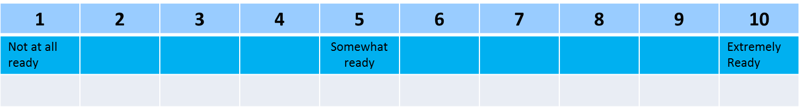
Readiness Ruler
On a scale of 1 to 10, how ready are you to make a change?

Slide 24

Linking Screening and Brief Intervention
MI strategies facilitate—
Finding personal and compelling reasons to change
Building readiness to change
Making commitment to change

Slide 25

The Personalized Reflective
Discussion
Uses screening/assessment results to generate a specific type of reflective discussion aimed at gently increasing readiness and the desire to change
Sampl & Kadden, 2001

Slide 26
Personalized Reflective Discussion
Enhancing motivation and commitment
Initiate reflective discussion
Negotiate commitment
Enhance motivation
Provide feedback
based on screening/
assessment data
Evoke personal meaning

Slide 27
Initiating Reflective Discussion
Start the reflective discussion asking permission of our patients to have the conversation.
Example: “Would it be all right with you to spend a few minutes discussing the results of the wellness survey you just completed?”

Slide 28
Providing Feedback
Substance use risk
Based on your AUDIT screening—
Score: 27
You are here
Low Moderate High Very High
0 40
Review
Score
Level of risk
Risk behaviors
Normative behavior

Slide 29
Evoking Personal Meaning
Reflective questions: From your perspective…..
What relationship might there be between your drinking and ____?
What are your concerns regarding use?
What are the important reasons for you to choose to stop or decrease your use?
What are the benefits you can see from stopping or cutting down?

Slide 30
Summarizing
Acknowledges the patient’s perceived benefits of use
Elicits the “personal and important” problems or concerns caused by use
Elicits, affirms, and reinforces motivation to change
Helps resolve ambivalence and reinforces motivation

Slide 31






Enhancing Motivation
Readiness Ruler

Slide 32

Negotiating Commitment
Simple
Realistic
Specific
Attainable
Followup time line
Negotiating
a
PLAN

Slide 33
Personalized Reflective Discussion Demonstrated
Personalized Reflective Discussion Exercise

Slide 34

Summary: Benefits of Using MI
E vidence based
P atient centered
P rovides structure
R eadily adaptable

Slide 35







Summarizing
Motivation for Change
Motivation is an intrinsic process.
Ambivalence is normal.
Motivation arises out of resolving discrepancy.
“Change talk” facilitates change.

Slide 36

What’s Next
In the next session, we’ll cover the brief negotiation interview, a semistructured brief intervention process based on MI that is a proven evidence-based practice.

