Slide 1

Engaging Young Adults into Wellness Screening & Interventions: A New Era for SBIRT
Win Turner, PhD, LADC
Cathleen Scully, DNP
Bridgette Akins, MA
Jody Kamon, PhD

Slide 2

Acknowledgements
Young Adults involved in YSBIRT
SAMHSA Grant # TI081150
Collaborating Partners:
SPECTRUM YOUTH AND FAMILY SERVICES, INC
Colleges: Champlain College, Castleton College, St Michael’s College, Middlebury College
Friends Research Institute
Keren Kinner ( C4BHI )

Slide 3
Presentation Outline – Novel Approaches
Decoupling SBIRT from the medical/health clinic
College SBIRT in action
Easing access to treatment for BIPOC & Latinx populations
Smartphone Contingency Management

Slide 4
Background & significance
High rates of substance use, mental health risk and low treatment engagement for young adults (18-24 years old) is a major healthcare problem.
VT SBIRT College Population Data consistently finds high risk for substance use and mood disorders.
Young adults have experienced a number of pandemic-related consequences, such as closures of universities, social isolation, financial & housing stress that may contribute to poor mental health.
Notes:
Young adults are known to be specially focused and fluent in online applications and thus maybe more ready to utilize campus wide electronic health approaches

Slide 5
Background & significance
During the pandemic:
  A larger than average share of young adults (ages 18-24) report symptoms of substance use & anxiety and/or depressive disorder (56%).
  Students were either off campus and/or the health & counseling care visits pivoted to telehealth demanding a new approach for universal screening to identify mental health, substance use risk and delivering matched interventions.
Notes:
The Implications of COVID-19 for Mental Health and Substance Use
Nirmita Panchal , Rabah Kamal , Cynthia Cox Follow @cynthiaccox on Twitter , and Rachel Garfield
Published: Feb 10, 2021

Slide 6
Background & significance
Understanding factors that improve acceptability and effectiveness of engaging students into electronic SBIRT (universal screening and matched interventions) has widespread implications for efficiently impacting wellness on campus.
Notes:
The Implications of COVID-19 for Mental Health and Substance Use
Nirmita Panchal , Rabah Kamal , Cynthia Cox Follow @cynthiaccox on Twitter , and Rachel Garfield
Published: Feb 10, 2021

Slide 7

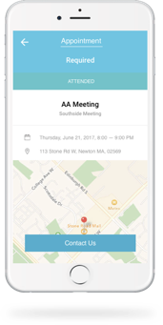



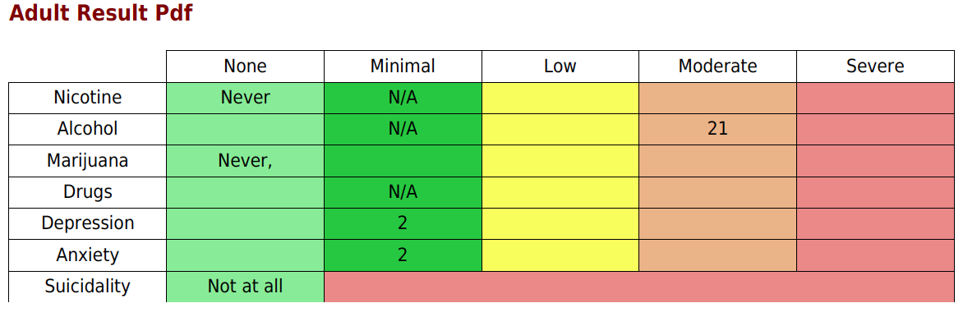

Implementation components
Wellness Staff
Web-based Health Screening
Automated Feedback & Resources
Calendar Links to appointments
Incentives
Evaluation & CQI
Notes:
Package of available intervention options all students received rewards for biometric testing, recovery coaching, and survey completions – others added rewards for activities and CBT modules.

Slide 8
Example: Electronic Resources
Screening Tool:
Clinical Report
Intervention link
CQI Reports = next slides

Slide 9
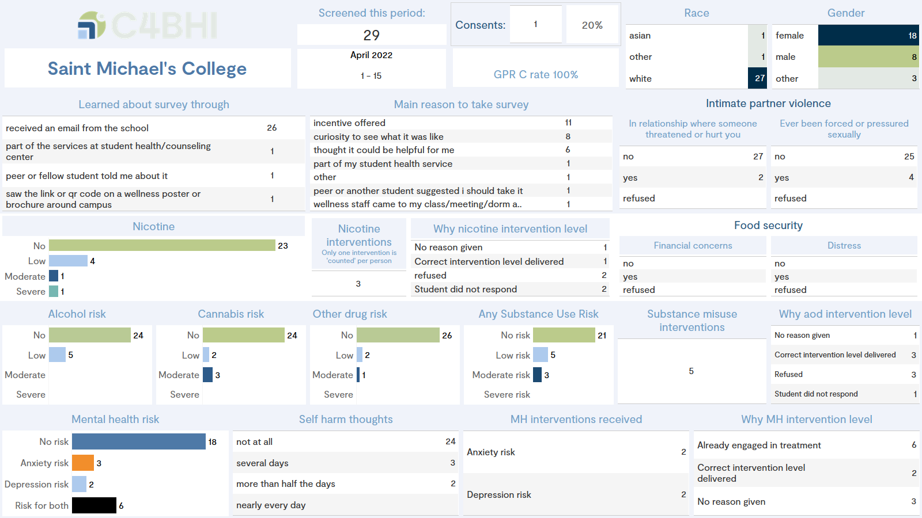

Slide 10
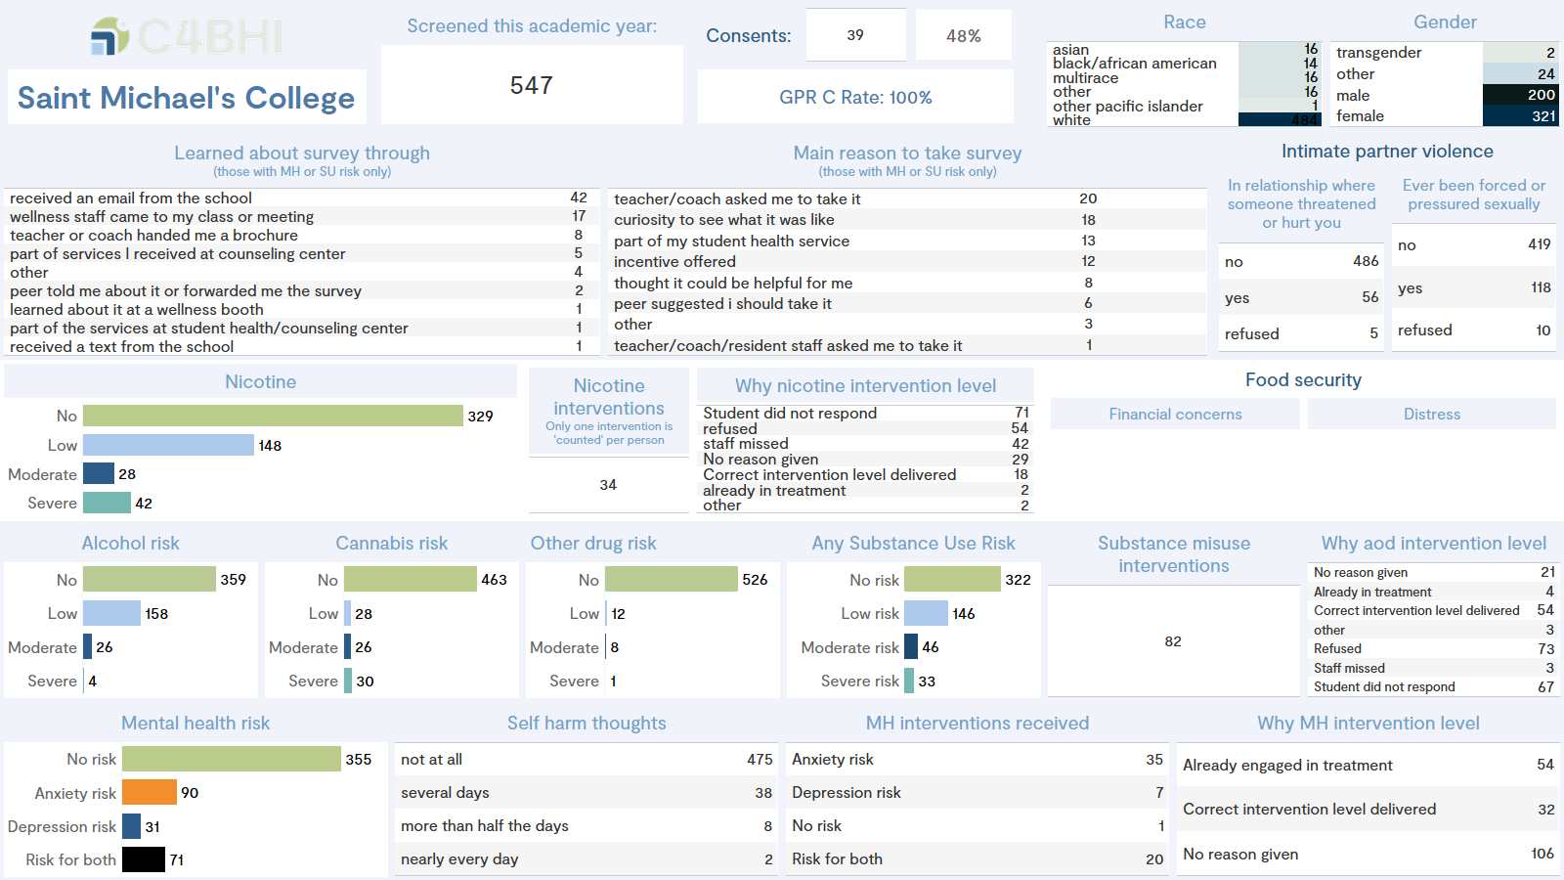

Slide 11
Exporatory questions
Is decoupling SBIRT from medical setting feasible for young adults?
What are young adult prevalence rates for MH & SA considering COVID impact?
Will only certain types of students accept screening invitation?
Will certain “college screening events” be more impactful than others?
Do incentives matter from the students’ perspective?
Which types of students ( by risk level, by demographic factors ) will engage in interventions not linked to health appointments?
Notes:
Young adults are known to be specially focused and fluent in online applications and thus maybe more ready to utilize campus wide electronic health approaches

Slide 12
Methods
As part of an YSBIRT grant agreement, students offered screening links by email, text, in class, in resident halls, at group events, on sports teams, or at the college wellness/counseling centers on campus.
SBIRT electronic suite of evidence based screening tools used for substance use, mental health and other risk factors.
Post-screen youth received resources from wellness staff and those positive for risk were offered to connect by phone, and/or in person with wellness staff.
Notes:
Young adults are known to be specially focused and fluent in online applications and thus maybe more ready to utilize campus wide electronic health approaches

Slide 13
Methods
REDCap platform required wellness staff to track all student’s identified with risk as either non responders or responders to an intervention.
Surveys sent monthly (via Alchemer platform) to staff to track event type and incentives offered to associate efforts to screening number.
All activity occurred during the 2021-2022 academic year.
Notes:
Young adults are known to be specially focused and fluent in online applications and thus maybe more ready to utilize campus wide electronic health approaches

Slide 14
Demographics
College | N | %
College 1 | 285 | 18%
College 2 | 399 | 26%
College 3 | 548 | 35%
College 4 | 326 | 21%
Total | 1558 | 100%
**16% of the students were BIPOC- black, indigenous and other people of color
* 3 out of the 4 colleges had a majority of female students

Slide 15
Overall, 41% are at risk for mental health; 10% of students (n=164) experienced thoughts of self harm.
Overall, 35% are at risk for substance use risk, not including nicotine.
Notes:
Risk level %’s by substance type is intriguing and we will look further into this …

Slide 16
Among those with SU risk, a smaller proportion endorsed impacts of alcohol use compared to cannabis and other drug use.
For those with MH risk, proportion with low, moderate & severe risk similar across depression, anxiety & both.
Notes:
Note: Nicotine excluded as risk is based on frequency of use only.

Slide 17
Across all types of risk, significantly higher proportion of young adults endorsing risk compared to the overall sample.
N = 223 with Co-occurring Risk

Slide 18
How I learned about the health survey?
Notes:
This table reflects how the wellness staff were attempting to reach students – the next slides illustrate which methods were the most effective
As you can see, wellness staff resorted to a number of varied methods to reach students.

Slide 19
Response rate by outreach method
Context Variable | Subcategories | Freq | Mean | SD | Prob>F
Introductory meetings held | Yes | 19 | .534 | .40 | .300
 | No | 17 | .399 | .37
Distributed during event | Yes | 23 | .563 | .38 | .036
 | No | 13 | .285 | .34
Distributed after event | Yes | 14 | .260 | .27 | .010
 | No | 22 | .592 | .40
Specific student group | Yes | 16 | .653 | .33 | .006
 | No | 20 | .311 | .37
Social media announcement | Yes | 9 | .426 | .33 | .747
 | No | 27 | .475 | .41
Incentive for survey | Yes | 23 | .583 | .35 | .011
 | No | 13 | .251 | .36
Incentive for event | Yes | 9 | .189 | .19 | .011
 | No | 27 | .554 | .39
Distributed by other | Yes | 0 |  |  | N/A
 | No | 36
QR codes used | Yes | 23 | .563 | .38 | .036**
 | No | 13 | .285 | .34
Distributed via email | Yes | 16 | .348 | .345 | .110
 | No | 20 | .555 | .40
SBIRT staff follow-up | Yes | 16 | .588 | .33 | .082
 | No | 20 | .363 | .41
**QR codes handed out during events.
Notes:
Series of ANOVA all colleges combined analyses comparing presence or absence of contextual event indicators on percent of surveys completed for events where the SBIRT staff member was Present vs. Not Present.
Live events, outreach via specific groups, and the use of incentives engendered significantly greater response rates. We would consider these methods to be more present, active methods vs. more passive, less present methods.

Slide 20
Rates of survey return by presence (or absence of wellness staff
Green shading indicates increased response rates

Slide 21
Why I took the health survey?
Notes:
This table reflects why students chose to fill out the survey. As you can see, the primary three reasons were because they were curious or felt it could be helpful, because a college staff asked them to or because an incentive was offered.

Slide 22
Intervention delivery rates
539 (35%) positive for substance use risk
10 (2%) already in treatment
181 (34%) of those at risk & not in treatment received an SBIRT intervention
649 (41%) positive for mental health risk
285 (44%) already in treatment
134 (37%) of those at risk & not in treatment received an SBIRT intervention

Slide 23
College SBIRT in Action
Bridgette Atkins
Wellness Coordinator
St. Michael’s College

Slide 24
What worked….
One Question
Captive Audience
Incentives
Meeting students where they are
  Zoom
Connecting to Purpose
  Relates to Mental Health
Notes:
Young adults are known to be specially focused and fluent in online applications and thus maybe more ready to utilize campus wide electronic health approaches

Slide 25
Obstacles and areas to grow
COVID
Decreasing Stigma
  Continuing to grow SBIRT as a campus wide effort
Increasing Accessibility
  Meeting students where they are literally
  Self -Driven Motivational Intervention
Notes:
Young adults are known to be specially focused and fluent in online applications and thus maybe more ready to utilize campus wide electronic health approaches

Slide 26
Closing thoughts
"People don’t always need advice. Sometimes all they really need is a hand to hold, an ear to listen, and a heart to understand them." - Anonymous
"When "I" is replaced by "WE" even illness becomes wellness." ~ Malcolm X
Notes:
Young adults are known to be specially focused and fluent in online applications and thus maybe more ready to utilize campus wide electronic health approaches

Slide 27
One college’s attempt to ease access to treatment services for BIPOC & Latinx students with risk

Slide 28
Background
Data from Y1 implementation showed that Champlain’s BIPOC & Latinx students reported disproportionately higher levels of risk for mental health & substance misuse.
For example, BIPOC students comprised only 10% of the student body, but 20% of those reporting thoughts of self-harm identified as BIPOC.
Champlain College is a predominantly white institution in one of the whitest states in the country

Slide 29
Background
Champlain Health & Wellness made an effort to increase access to culturally relevant and affirming mental health treatment for BIPOC & Latinx students.
The YSBIRT grant help to identify students in need and provide resources for this population to access culturally affirming treatment and matched appropriate levels of care as needed.

Slide 30
How it worked
To apply to the BIPOC Therapy Resource, students:
  Filled out a brief contact information form
  Completed the YSBIRT screen
  Met with a Champlain Student Health & Wellness Provider for an intake appointment.
The provider worked with each student to find a clinician who was in good professional standing, though the choice of therapist was ultimately the student’s.

Slide 31
How it worked
Critically important was Vermont’s pandemic-related licensing flexibility that allowed people located in Vermont to receive telehealth services from providers anywhere in the country.
The Resource issued payments to 15 clinicians in 6 states (VT, MA, NY, NJ, NC, LA)
A total of 37 students applied for the BIPOC Therapy Resource.
  35 students met with a provider for an intake appointment.
  13 students fully engaged with therapy and completed 10+ awarded sessions.
  4 students were connected to Champlain College Counseling.
  3 students were connected to a provider and fully covered by their own insurance.

Slide 32
What we learned
Twenty-two students completed the 6-months post-service Exit Survey.
  95% of respondents affirmed that “because of the talk I had with the Champlain staff, I've thought about or am doing things that will improve my mental health”.
  Mean scores for respondents’ Anxiety and Depression decreased significantly over time.
  The mean GAD (anxiety) score at intake was a 10, down to a 4.8 at follow up.
  The mean PHQ (depression) score at intake was 10.1, down to 4.6 at follow-up.

Slide 33
What has this opportunity meant to you?
“A chance to feel connected with a therapist and be able to trust therapy overall again. I've put off trying to access therapy for years, not only because of lack of support finding a therapist but also the cost of therapy is much more than I can afford even with insurance.”
“The opportunity to even be able to speak about how I feel to someone that cares about helping me makes me overwhelmingly happy. Especially considering how most of my thoughts and feelings I keep to myself. I can speak about how I feel and instead of having it bottled up someone can help me work through these problems and conquer them. I wouldn't have reached out if I hadn't received an email that provided me with this resource. I needed it but I didn't know how to start. The BIPOC Therapy Resource made it easier for me to find that starting line.”

Slide 34
Should the BIPOC therapy resource continue to be made available to Champlain’s BIPOC students?
“Definitely!! Not many people seek professional help when they need it and Vermont is very white, which can make it more demotivating for people of color to seek out help for mental health. I was really excited when I heard about the services; it's just unfortunate that I had so much on my plate and couldn't make time for anything else. My first meeting with Erika was very helpful and encouraging, I really appreciated getting to meet with her and the support you all are willing to give.”
“Yes please. From my experience as a BIPOC and leaving my predominantly BIPOC community, coming to Vermont was such an insane change. Culture shock almost made me drop out if I hadn't found my friends at ODI. A lot of BIPOC communities and households keep mental health a secret or don't talk about it all, some BIPOC students may be drowning in mental health issues and be too reluctant/afraid to reach out because they don't know how to take that step. Having this resource available can help influence these crucial decisions. It can give student who would've crumbled under the burden of many mental issues have a fighting chance at being stable.”

Slide 35

Advancing Smartphone CM Beyond Feasibility
A Telephone/App Based Solution for college students: Evaluating acceptability and impact on nicotine, alcohol and cannabis use
Jody Kamon, PhD & Win Turner, PhD, LADC
Center for Behavioral Health Integration

Slide 36
Advancing Smartphone CM Beyond Feasibility
A Telephone/App Based Solution for college students: Evaluating acceptability and impact on nicotine, alcohol and cannabis use
Background and Significance
Contingency management (CM) is a highly effective but rarely used method to reduce substance use.
Young adults are known to be specially focused and fluent in online applications and may be more interested in a technology based CM approach for reducing their substance use.
Given young adults are at the age of emerging independence – what extent of choice vs. direct guidance is most effective in engaging digital self directed treatment
Notes:
Researchers wondered how to engage and successfully work with young adults who in previous SBIRT projects ay university/college had little interest in substance use treatment. Of particular concern were behaviors when binge drinking and researchers wanted to try different novel interventions to diminish potential health risks as well as increase awareness and reward for utilizing alternative wellness activities.
College students experience various life transitions and stressors that increase their risk of mental disorders (e.g., depression, anxiety, eating disorders, substance use disorders, and suicidal behavior; Hunt, Eisenberg, & Kilbourne, 2010)..
The college environment offers easy access to drugs and alcohol, and college cultures often promote the misuse of substances (Laudet, 2008). SBIRT data collected in Vermont from 2015-2021 found 22% of college students entering health center had some risk for substance use.
Substance use disorders are also highly stigmatized, with many in the general public attributing these conditions to a moral deficiency or lack of willpower. This creates challenges for students who want to be open about their recovery efforts, a necessary condition to build a supportive network of peers and access support services.
D. The stress and social isolation of the pandemic also created an increase in MH symptoms and likely an increase in SA as a way of coping?
Given the high comorbidity between substance use disorders and these other mental illnesses, and the major consequences of substance use problems on college campuses (e.g., increased likelihood of injury and violence, interference with academics), substance use problems cannot be considered separate from mental health issues (Minkoff, 2001).

Slide 37

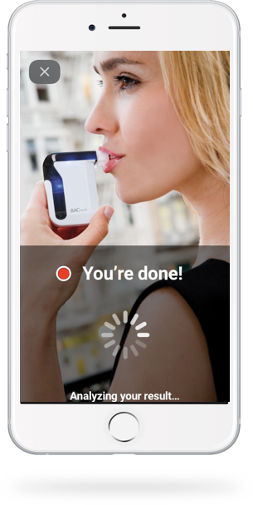
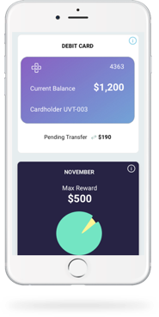

Study Interventions
Recovery Coaching
Remote Substance Testing
Medication Adherence
Appointment Tracking
CBT Modules
Virtual Recovery Support
Financial Rewards
Notes:
Package of available intervention options all students received rewards for biometric testing, recovery coaching, and survey completions – others added rewards for activities and CBT modules.

Slide 38
2 Phases – Acceptability and then outcomes
Phase 1 Hypothesis: Young adults identified with substance risk through SBIRT screening (Alcohol, Cannabis, Nicotine) and offered smartphone based CM will accept and engage with smartphone app platform.
Phase 2 Hypothesis: A targeted approach to CM in young adults in which they are guided into choosing the substance of greatest risk severity will lead to greater decrease in risky substance use without sacrificing engagement in intervention elements.
Notes:
Phase 1 included the first cohort of students. For Phase 1, we wanted to understand if the intervention was acceptable and feasible among college students.
For phase 2, we wanted to see if we could engender stronger reductions in substance use by targeting the substance of greatest severity of risk as the primary focus of the intervention.

Slide 39
Methods
Students initially screened as part of a college health center’s SBIRT effort
Evidence based tools for alcohol, marijuana, other drugs and a frequency item for nicotine
Those positive for risk were offered opportunity to sign up for smartphone-based contingency management (CM)
Enrolled participants received initial, 3 & 6 month data assessments
Phase I Cohort | Phase II Cohort
Measuring feasibility & acceptability | Measuring impact
Students chose substance of focus | Substance of focus based on severity of risk
Notes:
Dates Phase 1 Cohort = Fall 2019 through June 2020
Dates Phase 2 Cohort = Fall 2020 through June 2021

Slide 40
Sample
 | Total | Phase I | Phase II
Sample size | 27 | 15 | 12
Mean age | 20.2 | 20.3 | 20.0
SD | 1.6 | 1.9 | 1.2
Male | 48% | 47% | 50%
Female | 37% | 33% | 42%
Transgender/ Nonbinary/Other | 15% | 20% | 8%
Hispanic/Latino | 11% | 13% | 8%
BIPOC | 30% | 33% | 23%
 | Total | Phase I | Phase II
Nicotine positive | 89% | 100% | 75%
Alcohol positive | 44% | 40% | 50%
Cannabis positive | 81% | 80% | 83%
Notes:
Our sample included 27 college students enrolled over 2 consecutive academic years. For phase 1, we had 15 participants and phase 2, 12.
You can see the demographics listed here along with the percentage of risk at intake for nicotine, alcohol and cannabis.
Risk for nicotine is the use of any nicotine. Alcohol is defined by a positive score on the Alcohol Use Disorders Identification Test.
Cannabis is defined as weekly or greater use and a positive score on the Drug Abuse Screening Test-10 items or Cannabis Intervention Screener.

Slide 41
Phase 1 outcomes: Acceptability & feasibility
There are an average of 90 CBT modules to choose from. On average, participants completed 3.2 per month or slightly less than 1 per week.
Students earned an average of $40 per month in incentives.
Cost averaged $220 per student per month.
Notes:
Phase I data indicated that students were engaged in the smartphone program over the course of 6 months, completing an average of 94% of wellness activities, 89% of recovery coaching calls and 74% of surveys each month. In addition, students completed an average of 3.2 online cognitive behavior therapy modules per month.
Students found it easy to enroll in the program, found it helpful in meeting their goals, were satisfied overall and would recommend the program to others.
Satisfaction surveys illustrated the majority of students found a) monetary incentives most helpful followed by b) recovery coaching, c) activity scheduling, d) CBT modules, and e) biometric testing.

Slide 42
Phase 1 outcomes: Changes in use
Indicator | Intake | 3 Months
Nicotine frequency* | 3.5 | 2.4
AUDIT score | 11.8 | 8.9
Past 30 day alcohol use* | 6.5 | 11.0
Past 30 day binge drinking | 3.2 | 3.0
Cannabis frequency | 3.8 | 3.7
Cannabis Intervention Screener | 6.2 | 6.7
Past 30 day cannabis use | 18.3 | 21.9
DAST-10 score | 1.1 | 1.0
Note1: Feb, 2020: 13 students active; by Aug: 10 students active.
Nicotine frequency range: 0=never to 4=daily; Cannabis frequency range: 0=never to 5=daily
*p<.05
Note2: 10 students self identified Nicotine as primary substance of focus (out of 15)
Notes:
While data indicated that students like using the smartphone app program, we saw mixed if limited changes in substance use.
Biometric testing demonstrated reductions in use although, as is common in treatment data, initial gains at the beginning of the program waned over time.
Across all other measures of substance use between intake and 3 months, we only saw statistically significant reductions in self reports on the frequency of nicotine use, consistent with biometric testing.
Interestingly, we saw a significant increase in the average days of past month alcohol use from intake to 3 months.
There were no other significant changes.

Slide 43
Phase 2 outcomes: Acceptability & feasibility
On average, participants completed 4.4 per month or approximately 1 per week.
Students earned an average of $40 per month in incentives.
Cost averaged $299 per student per month – greater cost for biometric testing with alcohol and cannabis compared to nicotine.
Students statements about their goals:
“I wanted to learn more about safe use of alcohol - I drank too much last year and will turn 21 soon and want to be more responsible.”
“I'd been using nicotine like my friends and I found myself when I turned 21 thinking I need to grow up and I got to kick this bad habit...wanted to be healthier and spend less money.”
“My only goal with the program was to limit my marijuana use. At first I wanted to cut it off completely, but I had trouble with it on the weekends so I compromised only limited myself during the weekdays and let myself smoke on the weekends.”
Notes:
Phase 2 data demonstrated similar levels of engagement and satisfaction. In addition, students in phase 2 completed more CBT modules on average compared to students in Phase I.
The cost per student per month was greater in Phase 2 as the cost for biometric testing was greater for alcohol and cannabis compared to nicotine. In addition, students were earning a greater number of incentives.

Slide 44
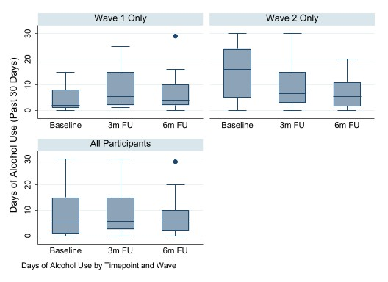
Wave 1 vs. 2 : Significant Changes in Alcohol Use
Alcohol Use
Robustly estimated negative binomial regression indicates participants in Wave 2 started off with more days of drinking per month than Wave 1, while also reducing their drinking more over time than Wave 1.
Notes:
dausealcoholdays | Coef. Std. Err. z P>|z| [95% Conf. Interval]
-----------------+----------------------------------------------------------------
timepoint |
3m FU | .7526326 .2745054 2.74 0.006 .2146119 1.290653
6m FU | .4902684 .2890658 1.70 0.090 -.0762901 1.056827
|
2.wave | 1.266493 .3746734 3.38 0.001 .5321468 2.000839
|
wave#timepoint |
2#3m FU | -1.35047 .336494 -4.01 0.000 -2.009986 -.6909536
2#6m FU | -1.298928 .4204887 -3.09 0.002 -2.123071 -.4747857
|
_cons | 1.488077 .2906013 5.12 0.000 .9185089 2.057645

Slide 45
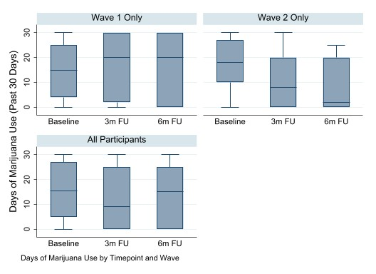
Phase 2 Outcomes: Significant Changes in Cannabis Use
Marijuana
Robustly estimated negative binomial regression indicates participants in Wave 2 decreased their marijuana usage more over time than participants in Wave 1, when measured as days of use in the past 30
Notes:
marijuanahashdays | Coef. Std. Err. z P>|z| [95% Conf. Interval]
------------------+----------------------------------------------------------------
timepoint |
3m FU | .1439161 .216838 0.66 0.507 -.2810786 .5689109
6m FU | .1480531 .2058144 0.72 0.472 -.2553358 .551442
|
2.wave | .2145965 .2696628 0.80 0.426 -.3139328 .7431258
|
wave#timepoint |
2#3m FU | -.6517827 .3126053 -2.09 0.037 -1.264478 -.0390876
2#6m FU | -.8369176 .377009 -2.22 0.026 -1.575842 -.0979936

Slide 46
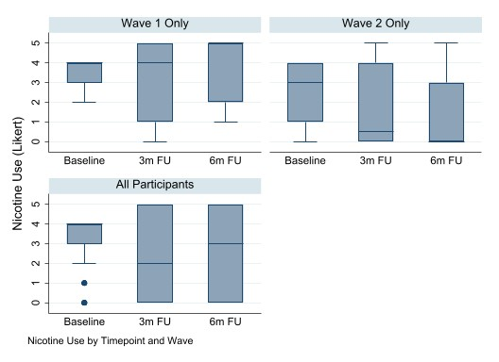
Phase 2 Outcomes: Significant Changes in Nicotine Use
Nicotine
Ordinal logistic regression indicates participants in Wave 2 self-reported greater reductions in nicotine use frequency by six-month follow-up when compared to Wave 1 participants.
Notes:
tobacco_nicotine | Coef. Std. Err. z P>|z| [95% Conf. Interval]
-----------------+----------------------------------------------------------------
timepoint |
3m FU | -.027764 .696331 -0.04 0.968 -1.392548 1.33702
6m FU | .6911624 .6724474 1.03 0.304 -.6268102 2.009135
|
2.wave | -.7620231 .3976917 -1.92 0.055 -1.541484 .0174383
|
wave#timepoint |
2#3m FU | -.6911373 .8895697 -0.78 0.437 -2.434662 1.052387
2#6m FU | -1.961999 .9017957 -2.18 0.030 -3.729486 -.1945122
-----------------+----------------------------------------------------------------

Slide 47
Universal on campus electronic screening de-coupled from health appointment is feasible and acceptable
Data collected as how and why students took screening illustrate the following:
Wide range of methods for engaging students in YSBIRT
“Present” methods seem to be more effective at engendering student response
Students have significant risk and those with substance use, less likely to already be engaged in services of any kind
Take Home Messages

Slide 48
Targeted CM in young adults feasible, acceptable, and promising
Guidance selecting CM targets for young adults is developmentally appropriate
Studying with a more robust sample size is needed to further explore the effectiveness of smartphone CM with college age populations engaging in risky substance use
Take Home Messages

Slide 49
Research is needed to further explore the effectiveness specific engagement approach with college age populations with mental health and substance use risk
New ongoing efforts include using:
automated self risk report;
list of defined incentives;
automated MET intervention for non-responders and
colleges standardizing SBIRT into curriculum for all students
Take Home Messages

Slide 50
Thoughts about the decoupling process?
Thoughts about how to further engage the students into screening
Thoughts about how to further engage the students into interventions
What do you think would be two or three adaptations we should try for next year?
Discussion Questions

Slide 51
THANK YOU!

