Slide 1
Public Safety Track
The CATALIST Model: A Community-Driven Response to Substance Use and Co-Morbid Behavioral Health Needs in Justice-Involved Youth
Lora Peppard, PhD, DNP, PMHNP-BC, Deputy Director for Treatment & Prevention, Director of ADAPT
Washington/Baltimore HIDTA
Eryn Mills, MA, MSC, LPC, Clinical Supervisor
Berkeley County Day Report Center
Whitney Maddox, MA, LPC, Supervisor, CATALIST Services and Support
Valley Health
Jody Kamon, PhD, Owner & Evaluation Director
Center for Behavioral Health Integration, LLC
Moderator: Tiffany Wilson, MPH, Deputy Branch Chief, Centers for Disease Control and Prevention

Slide 2
Faculty Disclosures
Lora Peppard, PhD, DNP, PMHNP-BC, has no financial relationships to disclose relating to the subject matter of this presentation
Eryn Mills, MA, MSC, LPC, has no financial relationships to disclose relating to the subject matter of this presentation
Whitney Maddox, MA, LPC, has no financial relationships to disclose relating to the subject matter of this presentation
Jody Kamon, PhD, has no financial relationships to disclose relating to the subject matter of this presentation
Tiffany Wilson, MPH, has no financial relationships to disclose relating to the subject matter of this presentation

Slide 3
Disclosures
The faculty have been informed of their responsibility to disclose to the audience if they will be discussing off-label or investigational use(s) of drugs, products, and/or devices (any use not approved by the US Food and Drug Administration)
Applicable CME staff have no relationships to disclose relating to the subject matter of this activity
This activity has been independently reviewed for balance
This CME activity includes brand names for participant clarity purposes only. No product promotion or recommendation should be inferred

Slide 4
Learning Objectives
Illustrate a community-driven model developed in response to identified substance use and co-morbid behavioral health needs in justice-involved youth and their caregivers
Compare the approaches and lessons learned from two unique communities in operationalizing the CATALIST model using their individual resources
Examine the preliminary quantitative and qualitative outcomes from the first two years of implementation

Slide 5
CATALIST OVERVIEW
C
A
T
A
L
I
S
T
ommunity-based
ssessment and
reatment for
dolescents & Families to
aunch
nterventions for
ubstances and
rauma
Notes:
Fixed spacing

Slide 6
CORE COMPONENTS
Community-Driven
Synthesis of feasible and acceptable evidence-based strategies
Youth & family centric
Promotes agency, ability, & HOPE
Eligibility Criteria
Location of Services
Primary Prevention
Collaborative Care
Identification & Screening
Early Intervention
Treatment
Recovery
Engagement & Integration of Caregivers
Notes:
Fixed spacing

Slide 7
EVIDENCE-BASED STRATEGIES
Collaborative Care Core Principles
Trauma Informed Care
Motivational Interviewing
SBIRT
This is Quitting vaping intervention
AIMS Behavioral Activation
Motivational Enhancement Therapy-Cognitive Behavioral Therapy (MET-CBT)
Cannabis Youth Treatment
Cognitive Behavioral Therapy for Depression and Anxiety
Trauma Focused-Cognitive Behavioral Therapy (TF-CBT)
Eye Movement Desensitization and Reprocessing (EMDR)
Brief Strategic Family Therapy
Contingency Management
Youth Peer Recovery Groups
Youth Peer Recovery Coaching
Catch My Breath
SAMSHA’s Talk. They hear you.

Slide 8
Primary Prevention in Public Schools
CATCH My Breath vaping prevention program
SAMHSA’s Talk. They Hear You.
The CATALIST Model
Services
Community Entry Points, Providers, & Responsibilities
Screening of Youth
Substance Use and Violence
Depression, Anxiety, Trauma
Social Needs, Belongingness, Resiliency, Family Cohesion, ACEs
Juvenile Justice System
Middle & High Schools
Emergency Departments
Early Interventions for Youth
Brief Interventions
Motivational Interviewing
Behavioral Activation
This is Quitting vaping intervention
CATALIST
Providers
CATALIST Providers
SBIRT or CATALIST Providers
Treatment for Youth
MET/CBT, Cannabis Youth Treatment
Trauma-Focused CBT & EMDR
Brief Strategic Family Therapy
Licensed Professional Counselors or Clinical Social Workers
Manage all aspects of services and care navigation for CATALIST youth.
Screen caregivers and manage all referrals to treatment or services.
Coordinate Caregiver Support Groups and fishbowl engagement program.
Collect data for CATALIST Evaluator.
Recovery for Youth
Contingency Management
Youth Peer Recovery Group
Youth Peer Recovery Coaching
CATALIST Youth Recovery Coaches
Lead the Youth Recovery Group for the Virginia target area.
Provide peer support services to group members as needed.
Meet weekly with CSSC to discuss group members.
Services for Caregivers
Screening & Referral to Treatment: Substance Use & Behavioral Health
Caregiver Support Groups
Community Treatment Sites
Notes:
Fixed arrow pointing tto the bottom triangle

Slide 9
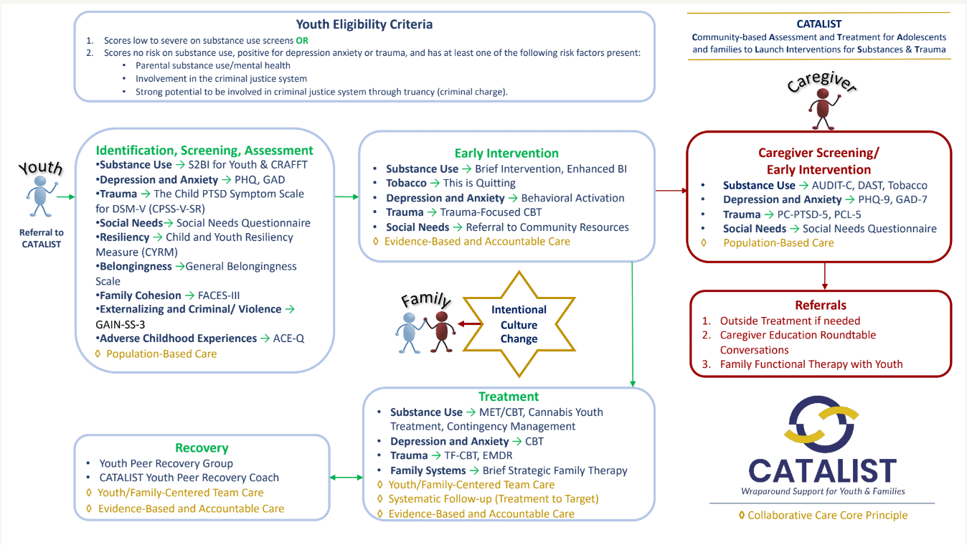

Slide 10
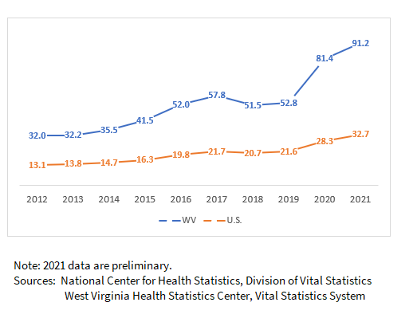
Community Needs Assessment
Need
Barriers
West Virginia consistently leads the nation in fatal overdoses
Berkeley County is among the top 8 counties for fatal overdoses in WV
Gap in Juvenile Justice system to identify risk and resources to appropriately manage those risks
Lack of healthcare professionals to treat juvenile population
No existing recovery groups for juveniles
Transportation

Slide 11
Community Partners
Berkeley County Juvenile Justice System
The Martinsburg Initiative
Berkeley County Schools
West Virginia University Health
Department of Health and Human Resources

Slide 12
Location of Services
Berkeley Day Report Center
Case Management
Individual Therapy
Family Therapy
Group Therapy
Peer Recovery Coaching
Caregiver Support Groups

Slide 13
Readiness Assessment
Community
Organization
People
Support of Berkeley County Council
Existing infrastructure for referrals for Adult Services
Strong, trusted relationship with Court System
Berkeley Day Report Center
Licensed Behavioral Health Center (2022)
Already providing continuum of care for Adult Referrals
Recognition of treating juveniles and families
Supportive relationship with the community based upon significant need
Advocates for services that were yet to exist
Credibility of existing strategies

Slide 14
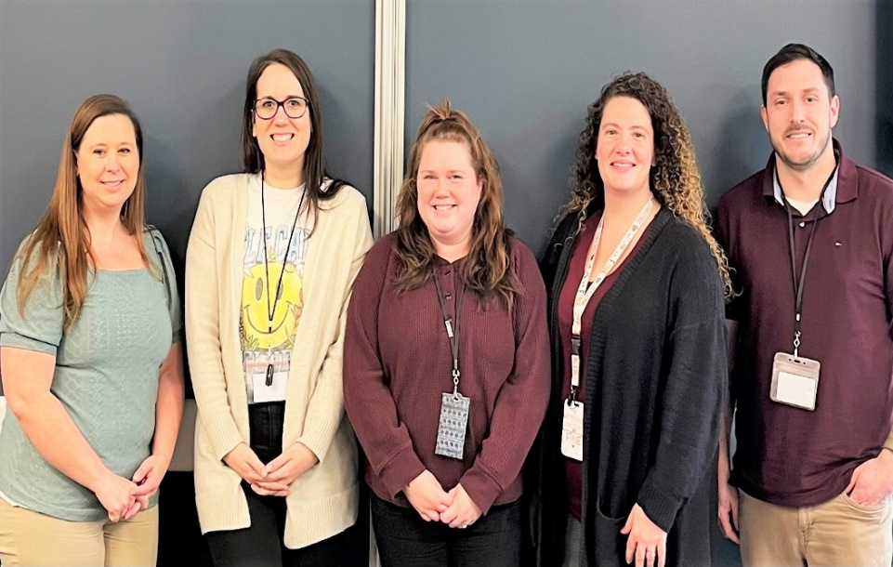
Foundation: Collaborative Care Core Principles
Patient-Centered Team Care
Population-Based Care
Measurement-Based Treatment to Target
Evidence-Based Care
Accountable Care
0
(AIMS Center, University of Washington, Principles of Collaborative Care: https://aims.uw.edu/principles-of-collaborative-care/)
Notes:
Added reference

Slide 15
Identification, Screening, & Assessment
CATALIST Case Manager
Identification of Needs, Risks, and Strengths
Population Based Care
S2BI for Youth & CRAFFT
PHQ and GAD
The Child PTSD Symptom Scale
Social Needs Questionnaire
Child and Youth Resiliency Measure
General Belongingness Scale
FACES-III
GAIN-SS-3
ACE-Q
CATALIST Case Manager administers screenings to youth during intake
CATALIST Case Manager reviews results and assigns appropriate treatment

Slide 16
Early Intervention
CATALIST Case Manager
Addressing Immediate Concerns
Evidenced Based and Accountable Care
CATALIST Case Manager provides appropriate early interventions based upon screenings and assessment
CATALIST Case Manager is trained in Early Intervention Strategies
Brief Intervention
This is Quitting
Behavioral Activation
Trauma-Focused CBT
Referral to Community Resources

Slide 17
Treatment & Recovery
CATALIST Therapist & Peer Recovery Coach
Individual Therapy
Contingency Management
Licensed Professional Counselors
Clinical Social Workers
Peer Recovery Support Specialist
Eye Movement Desensitization and Reprocessing
Family Therapy
Peer Recovery Group
Trauma Focused-CBT
MET/CBT
Peer Recovery Individual Coaching
Brief Strategic Family Therapy

Slide 18
Caregiver Participation, Screening, & Referral to Treatment
CATALIST Case Manager & Therapist
Identification of Risks, Needs, and Strengths
Population Based Care
Referral
CATALIST Case Manager facilitates care giver screens during intake
AUDIT-C, DAST, Tobacco
PHQ-9, GAD
PC-PTSD-5, PCL-5
Social Needs Questionnaire
Therapist provides individual therapy to caregivers
Outside referrals are made to community resources

Slide 19
Evaluation: Method
At intake, youth are asked to sign a consent for the evaluation
Re-administration of screening and assessment questionnaires
Administration of a 15-minute qualitative interview
Interviews explore goals, perceived impact of CATALIST program, and feedback on CATALIST services and experience
Family members who take part in treatment asked to participate too
Youth receive $20 and $30 gift cards for their participation
Quantitative analyses include chi-square, t-tests, and repeated measures ANOVAs
Interview transcripts analyzed in progressive annual cycles of coding and categorizing to generate themes and subthemes

Slide 20
Sample
268 Referred
Referral source (n=161) | N
Probation | 42%
Juvenile Drug Court | 12%
Court involved | 10%
School | 18%
Self | 9%
DHHR | 7%
NYAP | 1%
Other | 1%
161 engaged in services
35 currently active
51 successfully completed
75 discharged
Of those eligible for follow up, 51% or an n of 61 completed the 3- and 6-month follow up assessments
Unpublished data from CATALIST
Notes:
Slight reformatting of the table (moved each referral source to the right by one space).

Slide 21
Length of Stay
Sample
Variable | Features | Value
Gender | Female | 48%
 | Male | 52%
 | Gender Diverse | 0%
Age | Mean | 15.9 yrs
 | Standard Deviation | 1.3 yrs
 | Range | 12 to 18 yrs
Ethnicity | Latinx | 15%
Race | White | 86%
 | Black | 14%
 | Other | 5%
 | American Indian | 3%
 | Native Hawaiian/ Other Pacific Islander | 2%
 | Asian | 0%
Minimum recommended length of treatment for good outcomes
Unpublished data from CATALIST
Notes:
Added leading space in table, column #2

Slide 22
Food insecurity
Trouble paying utilities
Housing insecurity
Challenges with childcare
Lack of access to medical care due to cost
Lack of access to medical care due to transportation
Literacy challenges
Housing safety concerns
Lives with someone who uses substances
Lives with someone with mental health challenges
Unpublished data from CATALIST
Notes:
From Intake to 6 months post intake, 27% percent of youth went from experiencing 1+ SDoH to none. This change was significant at p=.004. Thus, there was some remediation of factors that can impact individuals' wellbeing including food insecurity, loss of utilities, housing insecurity, lack of access to medical care due to cost, lack of access to medical care due to transportation, and fear of being hurt at home.

Slide 23
Unpublished data from CATALIST
Notes:
Over time, youth decreased their use of substances. Youth are asked to report their patterns of substance use during the year prior to attending treatment and then, at each follow up point, they are asked to report on their use during the previous three months. From intake to 6 months later, use of nicotine decreased from 82% to 48%, alcohol decreased from 48% to 20%, and use of marijuana decreased from 78% to 37%. Importantly, 6 months after entering the CATALIST program, 48% had no risk or had decreased their risk level from their initial intake into the CATALIST program.

Slide 24
Urinalysis data (n=52) | N
First & last test negative | 52%
Last test negative | 23%
Total youth negative at end of treatment | 75%
Youth who participated in urinalysis screening completed an average of 21.4 tests during their time in treatment.
Unpublished data from CATALIST
Notes:
The CRAFFT is a health screening tool designed to identify substance use, substance-related riding/driving risk, and substance use disorder among youth ages 12-21. Scores on the CRAFFT can range from 0 to 6 with scores of 2 or over indicative of the likelihood of the presence of a substance use disorder. Mean scores on the CRAFFT decreased significantly from 2.8 to 1.5.
Toxicological screening results further support these self reported decreases over time. These youth completed an average of 21.4 tests (SD= 17.5) during treatment. Of the 52 youth who participated in testing, 75% were negative on their last screen with 52% testing consistently negative for all substances while an additional 23% initially tested positive but were negative by the end of treatment.

Slide 25
Unpublished data from CATALIST
Notes:
For depression, of those who completed a 6 month follow up, 54% consistently had no risk and an additional 34% had decreased their Depression risk level from their initial intake into the CATALIST program. Average scores on the PHQ 9 decreased from 7.4 to 2.5 (F = 12.53; p=.001; see Figure 1). Of the 61 youth with 6 month data, 22 scored in the Moderate to High risk range at intake. Importantly, among those 22 youth, average scores on the PHQ 9 decreased from 17.1 to 3.6.
For anxiety, of those who completed a 6 month follow up, 48% consistently had no risk and an additional 37% had decreased their Anxiety risk level from their initial intake into the CATALIST program. Average scores on the GAD 7 decreased from 6.5 to 3.0 (F = 7.86; p<.001). However, it is important to note that of the 61 youth with 6 month data, 21 scored in the Moderate to High risk range at intake. Importantly, among those 21 youth, average scores on the GAD 7 decreased from 15.2 to 4.5.

Slide 26
Unpublished data from CATALIST
Notes:
Trauma symptoms were assessed using the Child PTSD Symptom Scale Self Report measure. Trauma symptom questions are only asked of those who endorse experiencing at least one traumatic event. It is important to note that 65% of youth reported experiencing some form of trauma at the time of intake (n=39). Types of traumatic experiences reported include physical and/or sexual abuse/assault, witnessing domestic violence, and witnessing or experiencing the loss of a loved one.
Average scores of trauma symptoms decreased significantly across all youth who had reported experiencing trauma. These decreases become more pronounced when considering youth who scored in the moderated to very severe symptoms range at intake (n=24).

Slide 27
Qualitative Themes
Youth Outcomes
Family Outcomes
Improved healthy coping skills
Improved relationships with their
family
Changed harmful behaviors including
reducing substance use
Improved their attitude to be more
positive and less angry
Accomplished tasks they set for
themselves
Improved communication skills
Helped with emotional regulation
Increased respect and positive
attitude
Strengthened parenting coping
skills
Improved family culture
Improved trust
Notes:
Changed spacing and fixed sizing to make both headers/boxes the same size

Slide 28
Qualitative Themes
Program Activities: Individual Therapy
Program Activities: Youth Recovery Groups
Helpful and Caring Staff
Helped to set goals
Established trusting relationship with relatable therapist
Learned coping skills
Improved emotional regulation
Improved communication skills
Supportive community with people with similar experiences
Helped overcome fear of talking to others
Shown examples of people who are succeeding in changing behaviors
Checking in on youth and making sure they are staying on track with goals
Available to youths when needed
Encourage and support youth
Staff in recovery offer hope and understanding to youths
Share helpful advice
Notes:
Fixed formatting in box 1 to match the other two; Headers are now all the same font size; spelled out Youth Recovery Groups

Slide 29
In their own words…
“She made me realize that you can be normal. I had this whole mindset, because my mom, that once you are an addict you are stuck. Even when you got clean you were always going to be the same person. But I realized that people could overcome that and get better. Obviously, they will always be an addict, they will always have cravings and some issues with it, but I realized that some people can really overcome that and be amazing people.”
“I realized that I actually do matter and that a lot of people in this program has shown me that no matter what it is I'm going through, they can make time to help me. That was a big struggle of mine, not feeling like I mattered and that's definitely helped.”
“It was good because a lot of things got brought up in therapy that some of us struggled with that we didn't know that each other struggled with. Our therapist would give an example of what something that somebody could do to make them feel better. It would actually happen at my house, and it would improve the living environment.”

Slide 30
Limitations
Low follow-up rate among those who were discharged earlier and did not successfully complete services
We compared intake scores among those who completed the follow ups and those who did not
Out of 17 variables measured, only initial scores on the CRAFFT differed
Those who did not complete the follow up had a mean CRAFFT score of 3.5 and those who completed had a mean CRAFFT score of 2.8 (out of a possible 6)
Follow up timepoints extend to 6 months post intake into treatment. Ideally we would follow youth up at a later timepoint as well
Unpublished data from CATALIST

Slide 31
Winchester Community
Core Component Implementation
Facilitators of Success
Organizational Readiness
Staff Selection
Engaging Community Partners
Established connections with local Systems of Care consisting of partners from DSS, Schools, Courts, Providers, etc
Knowledge & Experience with program development and compliance with state regulations
Passion for the population
Flexible, creative, organized
Scheduling face-to-face meetings to solicit feedback
Defining the vision, goals and expectations under new leadership
Maintaining consistent, weekly communication report on status of referrals and updates on program
Doing what we say we will do 100% of the time
Connection to Purpose
Organizational and Departmental Vision of expanding services to children/adolescents
Organizational and Departmental infrastructure in place for adult services
Notes:
Fixed formatting in box 1 to match the other two; Headers are now all the same font size; spelled out Youth Recovery Groups

Slide 32
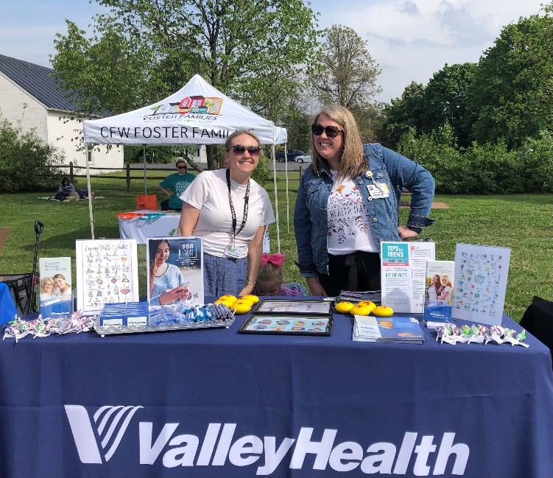
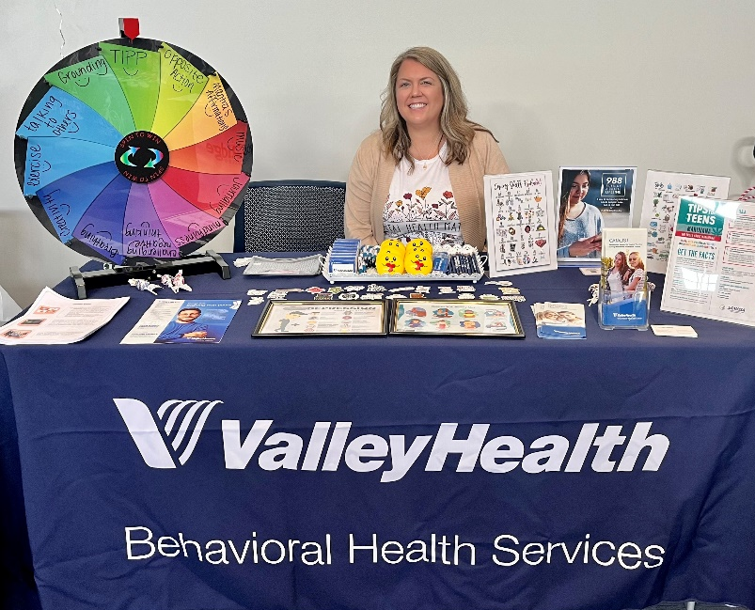
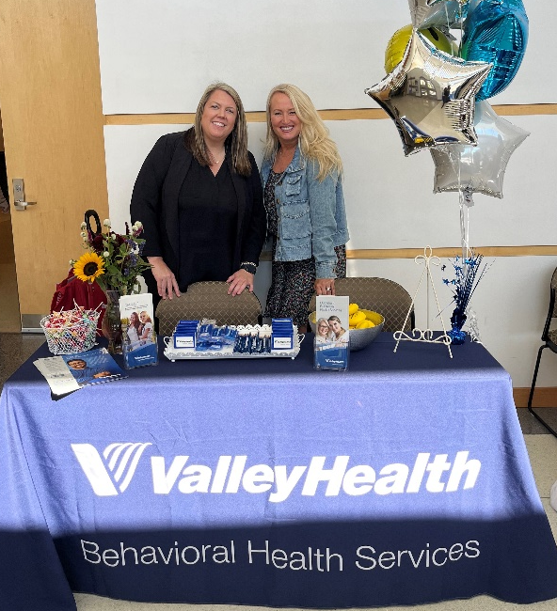
Engaging Our Community & Rebuilding Relationships
One Interaction at a Time!

Slide 33
Sample
110 Referred
Referral source (n=69) | N
Court involved | 46%
School | 28%
Self | 26%
69 engaged in screening or pending
20 enrolled in treatment
21 pending
28 screened & closed
5 were ineligible and 36 of those referred never responded.
Unpublished data from CATALIST

Slide 34
Sample
Variable | Features | Value
Gender | Female | 48%
 | Male | 52%
 | Gender Diverse | 0%
Age | Mean | 15.8 yrs
 | Standard Deviation | 1.4 yrs
 | Range | 12 to 17 yrs
Ethnicity | Latinx | 45%
Race | White | 60%
 | Black | 30%
 | Other | 15%
 | American Indian | 0%
 | Asian | 5%
 | Do not know | 5%
Data shown includes those who enrolled in CATALIST services.
To date, that includes 20 youth.
Unpublished data from CATALIST

Slide 35
Social Determinants of Health (N=20)
Unpublished data from CATALIST
Notes:
55% of youth identified experiencing at least 1 SDoH with 25% experiencing 2 or more.

Slide 36
Substance use risk level (n=20)
 | N | %
No risk | 1 | 5%
Low risk | 1 | 5%
Moderate risk | 4 | 20%
High risk | 14 | 70%
Unpublished data from CATALIST

Slide 37
Unpublished data from CATALIST
Notes:
The percent of youth who meet criteria for moderate to severe risk, a different picture emerges. At intake, 30% of youth score positive for moderate to severe risk for depression, 40% for anxiety, and a total of 65% of youth score positive for at least one of these types of mental health challenges. 55% of youth endorsed experiencing a traumatic event and across the entire sample of youth, 40% scored in the moderate to very severe range for experiencing trauma related symptoms. Types of traumatic experiences reported include physical and/or sexual abuse/assault, witnessing domestic violence, and being in a life threatening accident.

Slide 38
 | Externalizing Behaviors |  | Crime/Violence Behaviors
 | N | % | N | %
Low risk | 1 | 5% | 10 | 50%
Moderate risk | 8 | 40% | 9 | 45%
Significant risk | 11 | 55% | 1 | 5%
Total | 20 |  | 20
Unpublished data from CATALIST
Notes:
95% and 50% of youth scored in the moderate to high risk range on the Externalizing scale and Crime/Violence scales respectively, indicating they were endorsing experiencing symptoms within the past year. Moderate to high risk on the Externalizing Disorder Screener suggests the need for mental health treatment related to attention deficits, hyperactivity, impulsivity, conduct problems, and, in rarer cases, for gambling or other impulse control disorders. Moderate to high risk on the Crime and Violence Screener suggests the need for help with interpersonal violence, drug-related crimes, property crimes, and, in more extreme cases, interpersonal or violent crimes. Thus, youth referred to CATALIST are presenting not only with substance use concerns but with significant, clinical levels of mental health challenges.

Slide 39
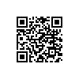
CATALIST Implementation Guide
Table of Contents
Part I: Core Components
Part II: Implementation Guidance
Part III: Evaluation
Part IV: Examples

Slide 40
Lora Peppard: lpeppard@wb.hidta.org

